Slide 1
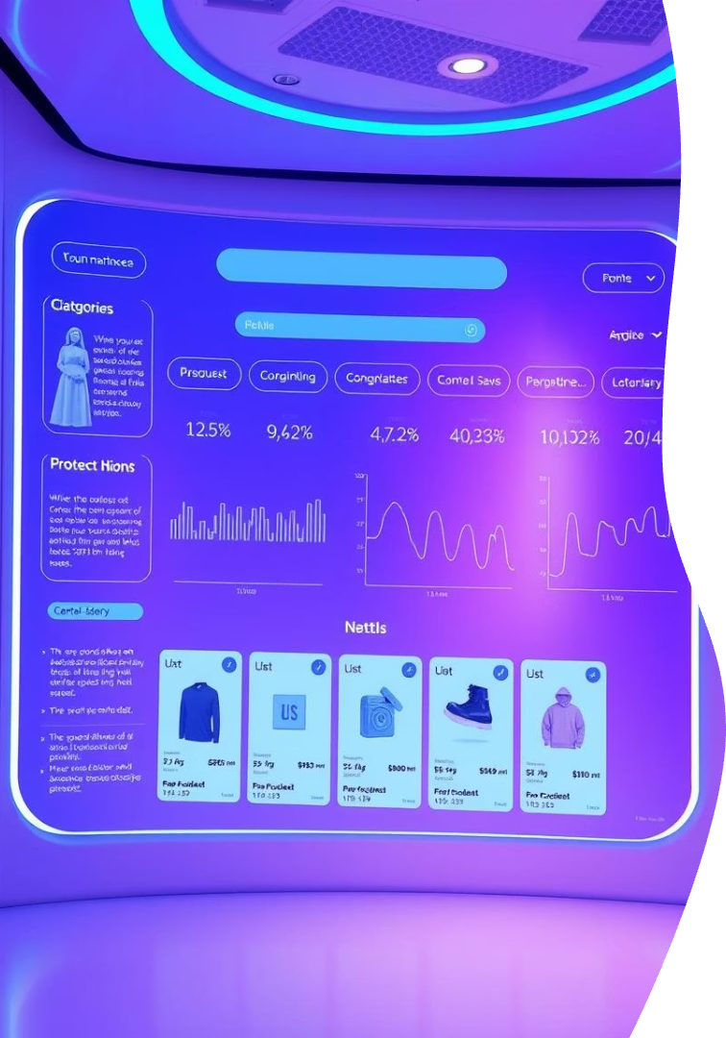
E-Commerce Product Classification and Analysis - Data Science
Presented by Jaisurya R
DA & DS
June 12, 2025

Slide 2
Objectives and Problem Definition
Key Objectives
Problem Definition
Classify products with machine learning
Manual classification is slow and error-prone
Extract real-time data via web scraping
Build ML models and Evaluate
Automated system needed for product attributes

Slide 3




Data Collection
Web Scraping
Data collected from Amazon
Key Features
Product name, price, discount, category
Brand, rating, review count
Data Storage
Stored in Pandas DataFrame

Slide 4





Data Cleaning and Preprocessing
Standardizing
Prices and discounts made numeric
Handling Missings and Duplicates
Missing values handled
Duplicates removed
Outlier Identification
Anomalies detected and addressed
Database Storage
Cleaned data stored in MySQL

Slide 5
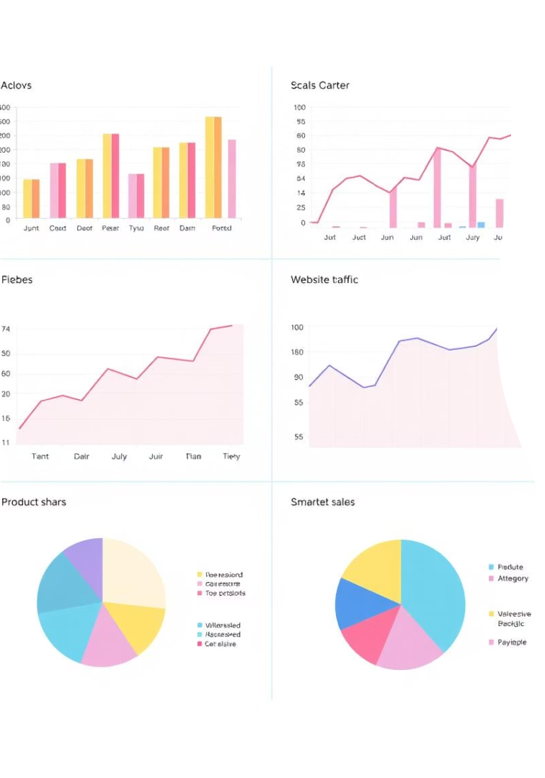
Exploratory Data Analysis (EDA)
Category Vs Price
Examines price distribution across categories.
Ratings per Category
Analyzes average ratings for each category.
Discount by Category
Reveals discount trends per category.
Correlation Heatmap
Visualizes relationships between attributes.

Slide 6
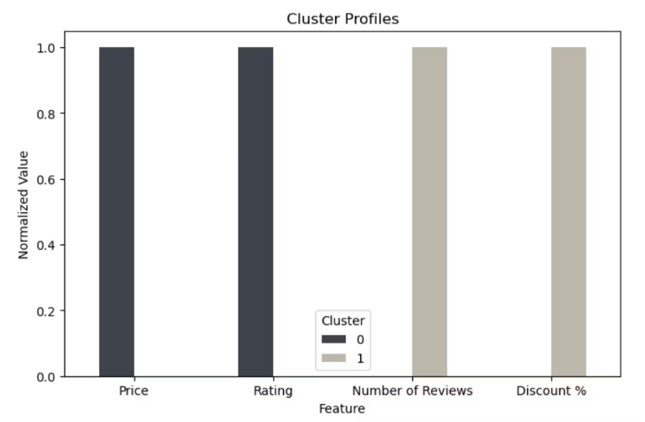
Unsupervised Learning: K-Means Clustering
K-Means Clustering groups products into distinct categories based on their features, identifying natural patterns within the data without prior labels.
How it Works
Divides products into clusters
Based on feature similarity
Automates product categorization

Slide 7
Supervised Learning: Model Building
Built and evaluated several supervised machine learning models to accurately classify products, focusing on key performance metrics.
Models and their Accuracy
Evaluation Metrics
Logistic Regression - 60%
Accuracy
Support Vector Machine (SVM) - 64%
Precision
K-Nearest Neighbors (k-NN) - 74%
F1 Score
Recall
Random Forest - 91%
XGBoost - 91%

Slide 8



Hyperparameter Tuning
Model Selection
Random Forest and XGBoost
Tuning Method
RandomizedSearchCV
Parameters Tuned
n_estimators, max_depth, min_sample_split
min_sample_leaf, max_features

Slide 9
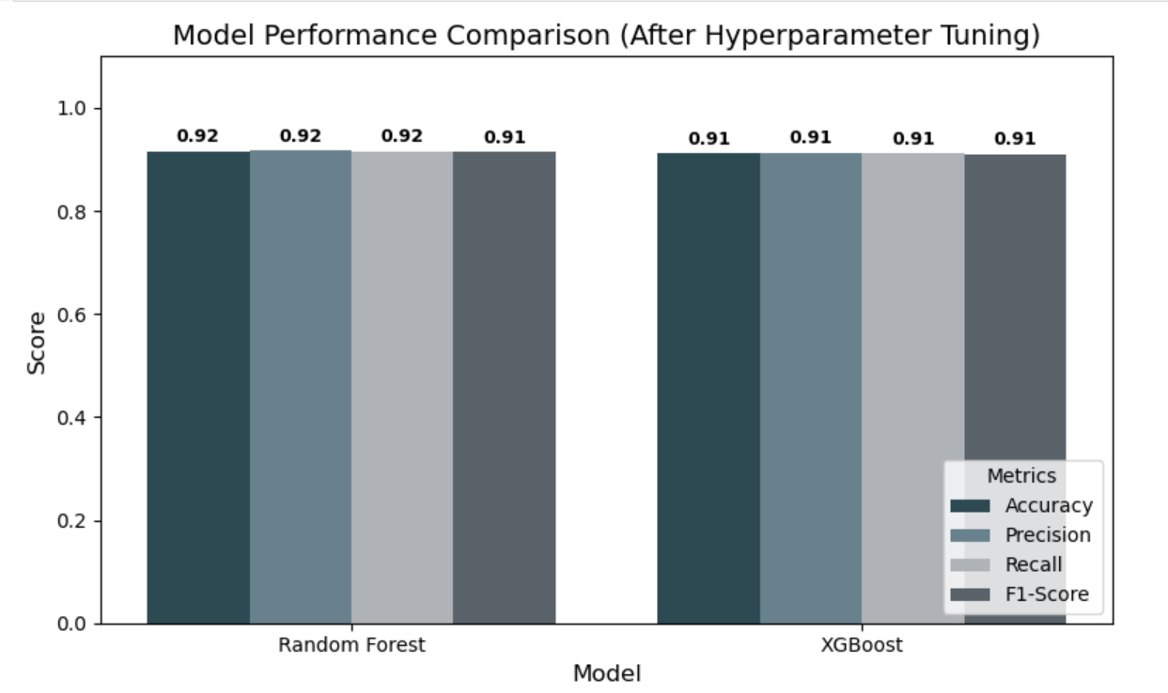
Performance After Tuning

Slide 10

Conclusion and Future Scope
Project Success
Key Insights
Future Enhancements
ML model built and evaluated
Pricing and discount trends.
Deploy via Streamlit or Flask.
Automated with scraped data
Category distributions analyzed
Use CNN for image classification.
Random Forest is The Best Model
Explore multi-modal predictions

Slide 11

Thank You

